Slide 1


Slide 2
Deferred Shading Optimizations
Nicolas Thibieroz, AMD
nicolas.thibieroz@amd.com
Notes:
Will be focused on DX11 but will also mention examples pertaining to previous APIs.

Slide 3






Fully Deferred Engine G-Buffer Building Pass
Render unique scene geometry pass into
G-Buffer RTs
Store material properties (albedo, normal, specular, etc.)
Write to depth buffer as normal
Depth Buffer
G-Buffer MRTs
G-Buffer MRTs
Notes:
Full Deferred engine

Slide 4





Fully Deferred Engine Shading Passes
Depth Buffer
G-Buffer MRTs
G-Buffer MRTs
Add lighting contributions
into accumulation buffer
Use G-Buffer RTs as inputs
Render geometries enclosing light area
Accum. Buffer

Slide 5


Fully Deferred: Pros and Cons
Scene geometry decoupled from lighting
Shading/lighting only applied to visible fragments
Reduction in Render States
G-Buffer already produces data required for post-processing
Significant engine rework
Requires more memory
Costly and complex MSAA
Forward rendering required for translucent objects
Notes:
May require more memory: especially if MSAA is used.
Forward rendering required for translucent objects: unless DX11 OIT solution is used

Slide 6






Light Pre-pass Render Normals
Render 1st geometry pass into
normal (and depth) buffer
Uses a single color RT
No Multiple Render Targets required
Depth Buffer
Normal Buffer
Notes:
Getting more and more popular. Described by Wolfgang Engel in his blog at http://diaryofagraphicsprogrammer.blogspot.com/2008/03/light-pre-pass-renderer.html
1st geometry pass.
Only access to geometries’ normal textures required at this point
May make for a cheaper first pass.

Slide 7






Light Pre-pass Lighting Accumulation
Normal Buffer
Depth Buffer
Perform all lighting
calculation into light buffer
Use normal and depth buffer as input textures
Render geometries enclosing light area
Write LightColor * N.L * Attenuation in RGB, specular in A
Light Buffer
Notes:
Multiple overlapping lights can be combined this way.
Add the result of light equations into light buffer.

Slide 8





Light Pre-pass Combine lighting with materials
Render 2nd geometry pass
using light buffer as input
Fetch geometry material
Combine with light data
Light Buffer
Depth Buffer
Output
Notes:
2nd geometry pass

Slide 9
Light Pre-pass: Pros and Cons
Scene geometry decoupled from lighting
Shading/lighting only applied to visible fragments
G-Buffer already produces data required for post-processing
One material fetch per pixel regardless of number of lights
Significant engine rework
Costly and complex MSAA
Forward rendering required for translucent objects
Two scene geometry passes required
Unique lighting model
Notes:
Less memory needed than fully deferred (no MRTs)
Allows materials with multiple diffuse or specular texture that may not fix into a traditional Gbuffer.
CONS: limited storage for materials (monochromatic specular)

Slide 10
Semi-Deferred: Other Methods
Light-indexed Deferred Rendering
  Store ids of “visible” lights into light buffer
  Using stencil or blending to mark light ids
Deferred Shadows
  Most basic form of deferred rendering
  Perform shadowing from screen-sized depth buffer
  Most graphic engines now employ deferred shadows
Notes:
LIDR: article in ShaderX7 book. Depth-only pass, plus full geometry pass
Store ids of “visible” lights into light buffer: the depth buffer (rendered as depth-only pass) is used to cull lights as with full deferred shading.

Slide 11
G-Buffer Building Pass
(Fully Deferred)
Notes:
Will be focused on DX11 but will also mention examples pertaining to previous APIs.

Slide 12







G-Buffer Building Pass Export Cost
GPUs can be bottlenecked by “export” cost
  Export cost is the cost of writing PS outputs into RTs
Common scenario as PS is typically short for this pass!
Pixel Shader
Argh!
MRT #0
MRT #1
MRT #2
MRT #3
G-Buffer
Notes:
Export cost typically increase if blending is enabled but this should not be the case of the G-Buffer “building” pass

Slide 13
Reducing Export Cost
Render objects in front-to-back order
Use fewer render targets in your MRT config
  This also means less fetches during shading passes
  And less memory usage!
Avoid slow formats
Notes:
Render objects in front-to-back order: sounds obvious but can really make a difference. Sorting front-to-back means less pixels written out to RTs (exported), thus reducing cost.

Slide 14
Export Cost Rules
AMD GPUs
Each RT adds to export cost
Avoid slow formats:
R32G32B32A32, R32G32, R32,
R32G32B32A32f, R32G32f, R16G16B16A16.
+ R32F, R16G16, R16 on older GPUs
Total export cost =
(Num RTs) * (Slowest RT)
nVidia GPUs
Each RT adds to export cost
RT export cost proportional to bit depth except:
<32bpp same speed as 32bpp
sRGB formats are slower
1010102 and 111110 slower than 8888
Total export cost =
Cost(RT0)+Cost(RT1)+...

Slide 15
Reducing Export Cost
Depth Buffer as Texture Input
No need to store depth into a color RT
Simply re-use the depth buffer as texture input during shading passes
The same Depth buffer can remain bound for depth rejection in DX11

Slide 16
Reducing Export Cost
Data Packing
Trade render target storage for a few extra ALU instructions
ALUs used to pack / unpack data
  Example: normals with two components + sign
ALU cost is typically negligible compared to the performance saving of writing and fetching to/from fewer textures
Aggressive packing may prevent filtering later on!
  E.g. During post-process effects
Notes:
Data packing allow a reducing in the number of RTs used
Aggressive packing may prevent filtering later on!: can consider filtering-friendly packing. If packing is filtering un-friendly then an additional “unpacking” pass will be needed.

Slide 17
Shading Passes
(Full and Semi-Deferred)
Notes:
Will be focused on DX11 but will also mention examples pertaining to previous APIs.

Slide 18
Light Processing
Add light contributions to accumulation buffer
Can use either:
  Light volumes
  Screen-aligned quads
In all cases:
  Cull lights as needed before sending them to the GPU
  Don’t render lights on skybox area
Notes:
Light processing is relevant for most deferred engines, either fully deferred or semi deferred.
Lights should still be culled as much as possible (e.g. Using CPU culling, or occlusion queries)
Add light contributions to accumulation buffer (or light buffer if using light pre-pass)

Slide 19
Light Volume Rendering
Render light volumes corresponding to light’s range
  Fullscreen tri/quad (ambient or directional light)
  Sphere (point light)
  Cone/pyramid (spot light)
  Custom shapes (level editor)
    Tight fit between light coverage and processed area
2D projection of volume define shaded area
Additively blend each light contribution to the accumulation buffer
Use early depth/stencil culling optimizations

Slide 20
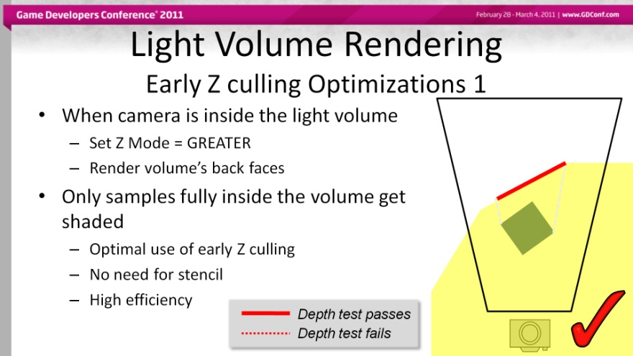
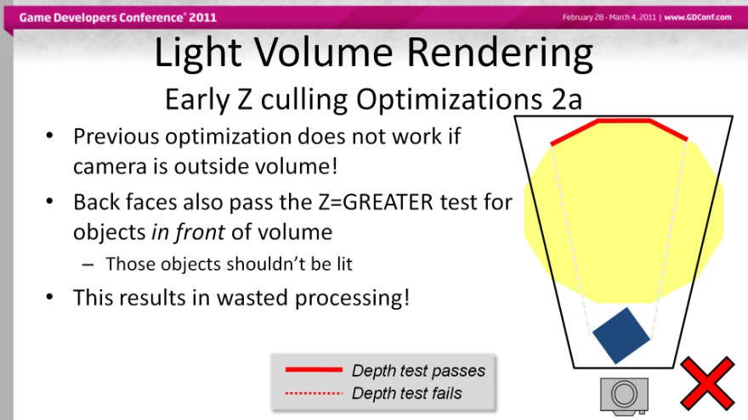
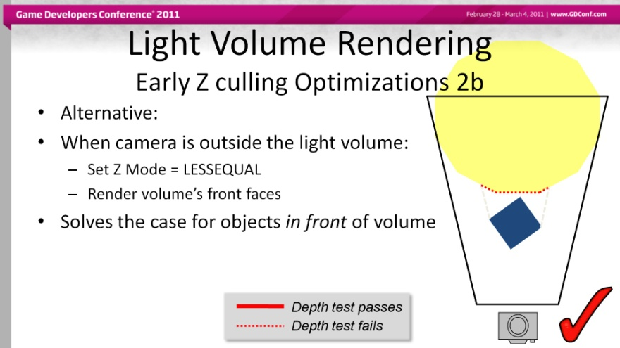
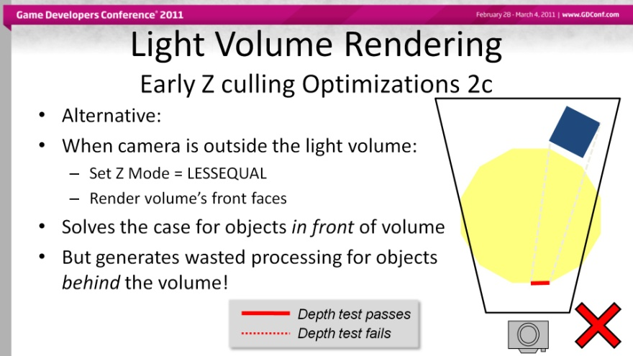
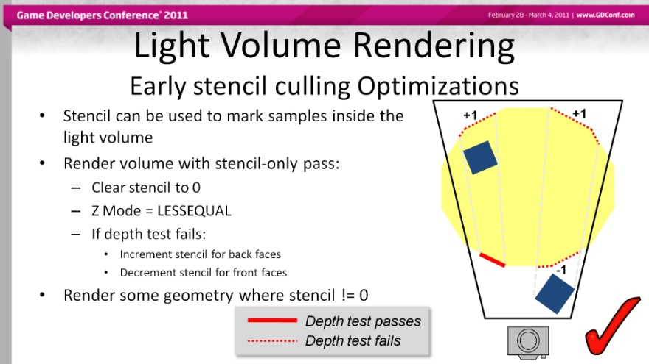
Light Volume Rendering
Full slides available in backup section
Notes:
No time to go through all optimizations for light rendering – check previous literature on the topic or see backup slides of this presentation.

Slide 21
Light Volume Rendering
Geometry Optimization
Always make sure your light volumes are geometry-optimized!
  For both index re-use (post VS cache) and sequential vertex reads (pre VS cache)
  Common oversight for algorithmically generated meshes (spheres, cones, etc.)
  Especially important when depth/stencil-only rendering is used!!
    No pixel shader = more likely to be VS fetch limited!

Slide 22
Screen-Aligned Quads
Far
Alternative to light volumes: render a camera-facing quad for each light
  Quad screen coordinates need to cover the extents of the light volume
    Simpler geometry but coarser rendering
Not as simple as it seems
  Spheres (point lights) project to ellipses in post-perspective space!
  Can cause problems when close to camera
Light
Near
Camera
Notes:
Not as simple as it seems: unless you’re doing it really naively with a bounding box around the sphere! This solution is too conservative as it generates too large an area to process.
Just transforming a sphere in view space and adding +/- XY radius to sphere centre before projection is only an approximation. This is because spheres project to ellipse in post-perspective space and thus simple projection will fail at extreme angles and/or when light is close to the camera.

Slide 23
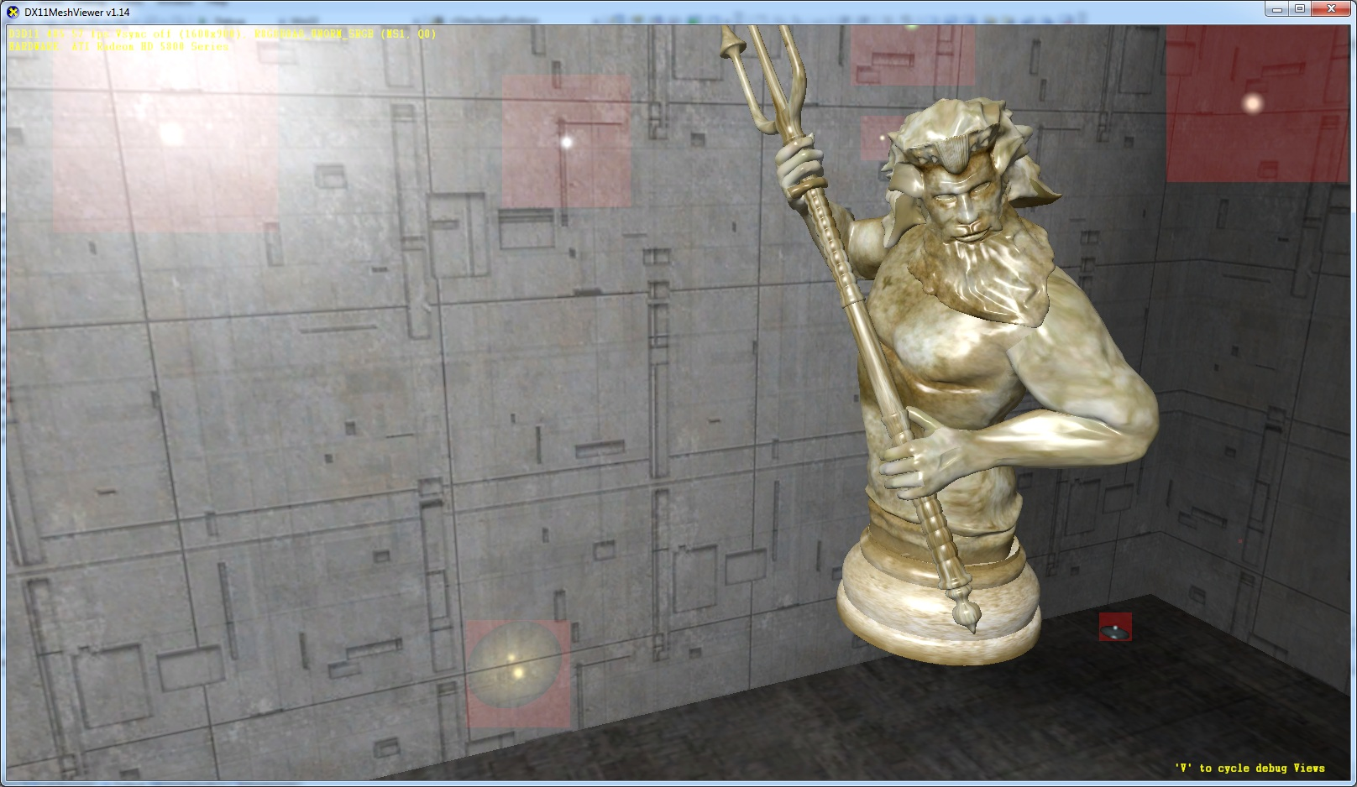

Points lights as quads

Slide 24
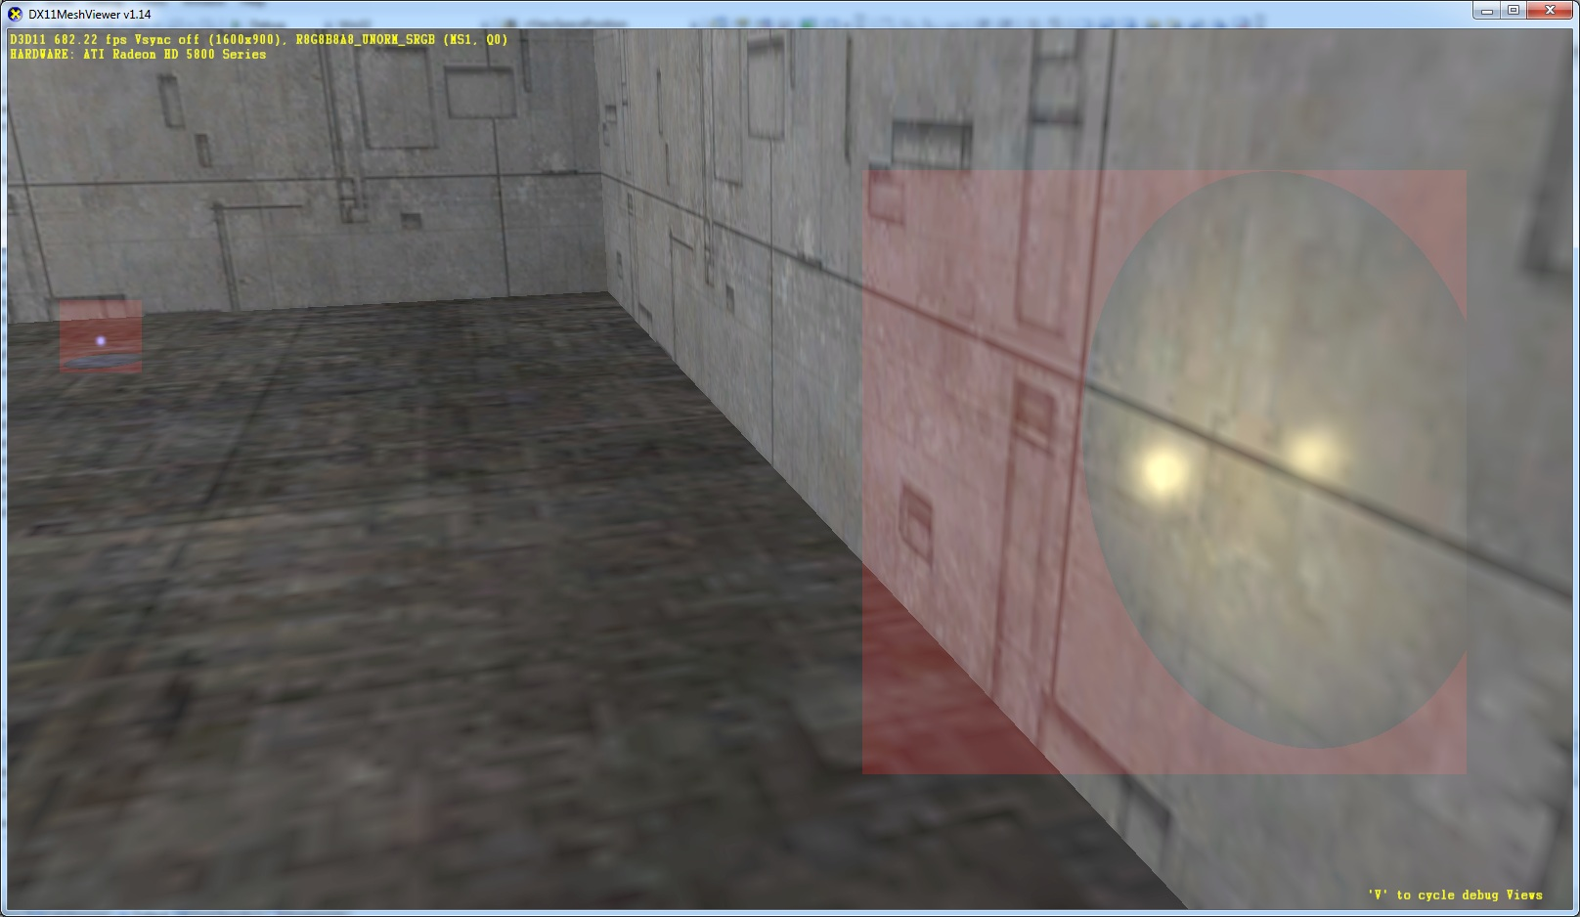
Incorrect sphere quad enclosure
Notes:
“simple” sphere projection yields a quad whose centre is always the position of the light source

Slide 25
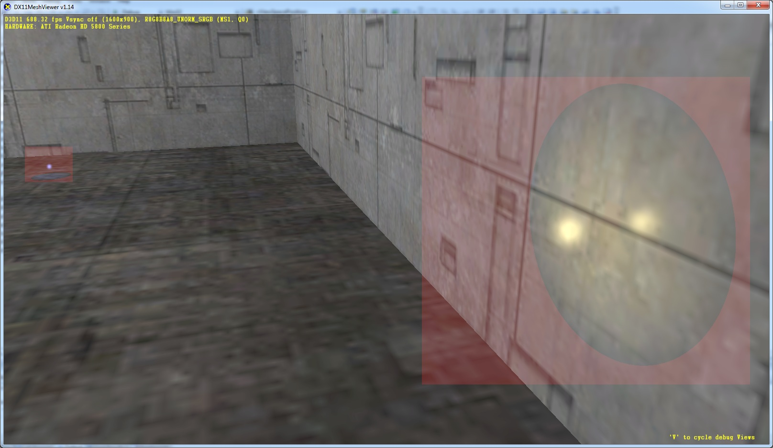
Correct sphere quad enclosure
Notes:
“correct” projection can have quad not centered around light source.

Slide 26
Screen-Aligned Quads 2
SwapChain:
Additively render each quad onto accumulation buffer
  Process light equation as normal
Set quad Z coordinates to Min Z of light
  Early Z will reject lights behind geometry with Z Mode = LESSEQUAL
Watch out for clipping issues
  Need to clamp quad Z to near clip plane Z if:
  Light MinZ < Near Clip Plane Z < Light MaxZ
Saves on geometry cost but not as accurate as volumes
LMaxZ
LMinZ
Notes:
Process light equation as normal: this can include shadows if needed
Set quad Z coordinates to frontmost Z of light volume: i.e. Point on the volume that is closest to the camera.

Slide 27
DirectCompute Lighting
See Johan Andersson’s presentation
Notes:
Process light equation as normal: this can include shadows if needed

Slide 28
Accessing Light Properties
struct LIGHT_STRUCT
{
float4 vColor;
float4 vPos;
};
cbuffer cbPointLightArray
{
LIGHT_STRUCT g_Light[NUM_LIGHTS];
};
float4 PS_PointLight(PS_INPUT i) : SV_TARGET
{
// ...
uint uIndex = i.uPrimIndex/2;
float4 vColor = g_Light[uIndex].vColor;
float4 vLightPos = g_Light[uIndex].vPos;
// ...
Avoid using dynamic constant buffer indexing in Pixel Shader
This generates redundant memory operations repeated for every pixel
Instead fetch light properties from CB in VS (or GS)
And pass them to PS as interpolants
  No actual interpolation needed
  Use nointerpolation to reduce number of shader instructions
PS_QUAD_INPUT VS_PointLight(VS_INPUT i)
{
PS_QUAD_INPUT Out=(PS_QUAD_INPUT)0;
// Pass position
Out.vPosition = float4(i.vNDCPosition, 1.0);
// Pass light properties to PS
uint uIndex = i.uVertexIndex/4;
Out.vLightColor = g_Light[uIndex].vColor;
Out.vLightPos = g_Light[uLightIndex].vPos;
return Out;
}
struct PS_QUAD_INPUT
{
nointerpolation float4 vLightColor: LCOLOR;
nointerpolation float4 vLightPos : LPOS;
float4 vPosition : SV_POSITION;
};
Notes:
AMD-specific advice.
This generates redundant memory operations repeated for every pixel
Better to move work up the pipeline

Slide 29
Texture Read Costs
Shading passes fetch G-Buffer data for each sample
  Make sure point sampling filtering is used!
  AMD: Point sampling filtering is fast for all formats
  nVidia: prefer 16F over 32F
Post-processing passes may require filtering...
  AMD: watch out for slow bilinear formats
DXGI_FORMAT_R32G32_*
DXGI_FORMAT_R16G16B16A16_*
DXGI_FORMAT_R32G32B32[A32]_*
nVidia: no penalty for using bilinear over point sampling filtering for formats < 128 bpp
Notes:
AMD: some GPUs can bilinear-filter DXGI_FORMAT_R16G16B16A16 _FLOAT at full speed.

Slide 30
Blending Costs
Additively blending lights into accumulation buffer is not free
Higher blending cost when “fatter” color RT formats are used
Blending even more expensive when MSAA is enabled
Use Discard() to get rid of pixels not contributing any light
  Use this regardless of the light processing method used
  if ( dot(vColor.xyz, 1.0) == 0 ) discard;
  Can result in a significant increase in performance!
Notes:
Use this regardless of the light processing method used: whether it’s using light volumes or quads

Slide 31
MultiSampling Anti-Aliasing
MSAA with (semi-) deferred engines more complex than “just” enabling MSAA
  “Deferred” render targets must be multisampled
    Increase memory cost considerably!
  Each qualifying sample must be individually lit
  Impacts performance significantly
Notes:
G-Buffer render targets must be multisampled (increase memory cost): you can get away with not using a MSAA accumulation buffer but you may need to convert MSAA depth buffer to non-MSAA depth buffer if you need further render ops requiring depth buffer

Slide 32
MultiSampling Anti-Aliasing 2
Detecting pixel edges reduce processing cost
  Per-pixel shading on non-edge pixels
  Per-sample shading on edge pixels
Edge detection via centroid is a neat trick, but is not that useful!
  Produces too many edges that don’t need to be shaded per sample
  Especially when tessellation is used!!
  Doesn’t detect edges from transparent textures
Better to detect edges checking depth and normal discontinuities
Or consider alternative FSAA methods...
Notes:
Edge detection via centroid is a neat trick: i.e. Declaring SV_POSITION with centroid interpolation mode and checking is interpolated variable ends with 0.5 or not. If not then edge pixel.
Better to detect edges checking depth and normals discontinuities: quite a few code examples exist that do this. Be careful when using depth from depth buffer: almost every sample will have a unique depth!
Overall MSAA is still a high cost with Fully-deferred engines; may want to consider alternative FSAA method like MLAA.
If using depth derivatives for edge detection then watch out for the case where depth buffer is used as G-Buffer since depth is unique per-sample due to MSAA!

Slide 33
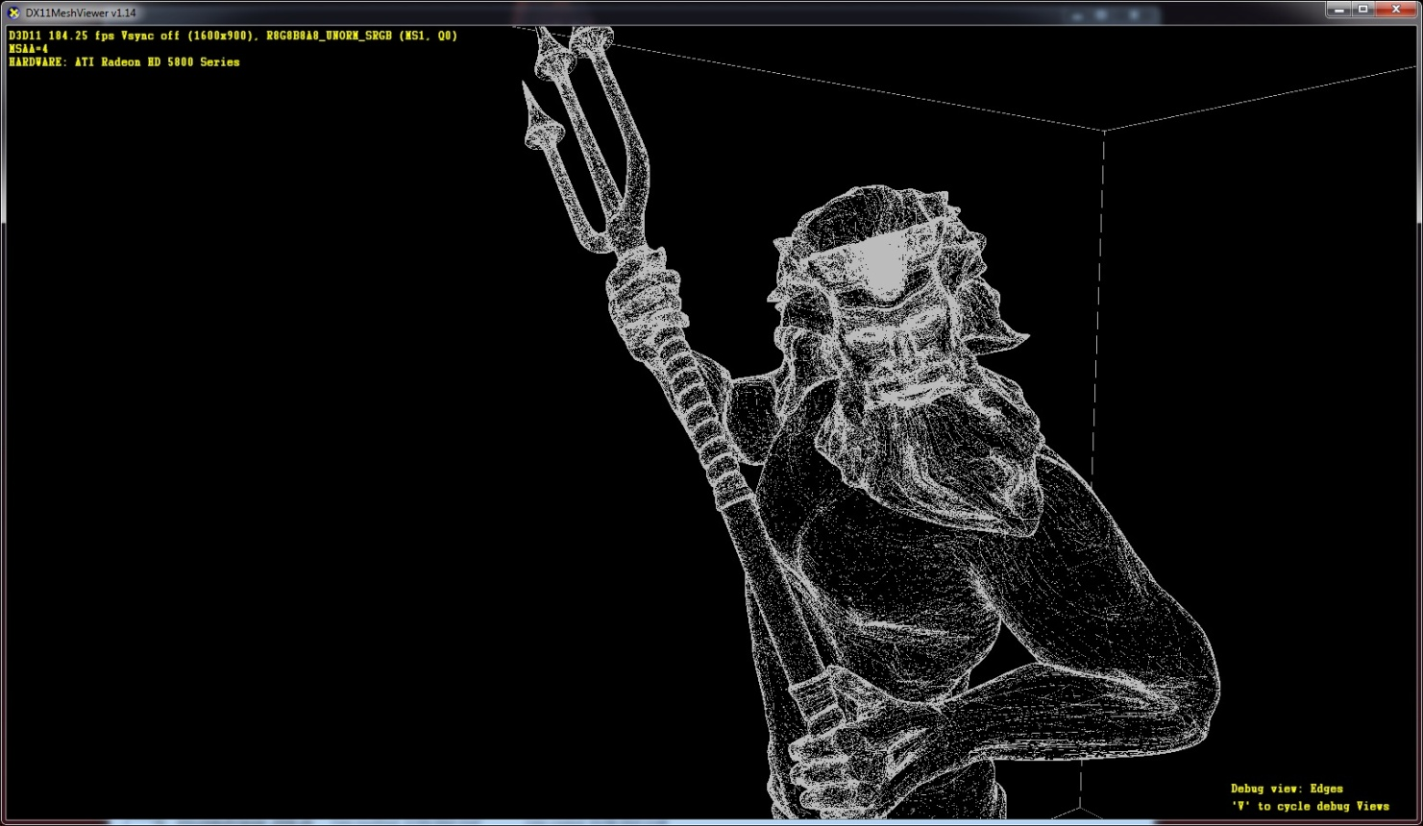
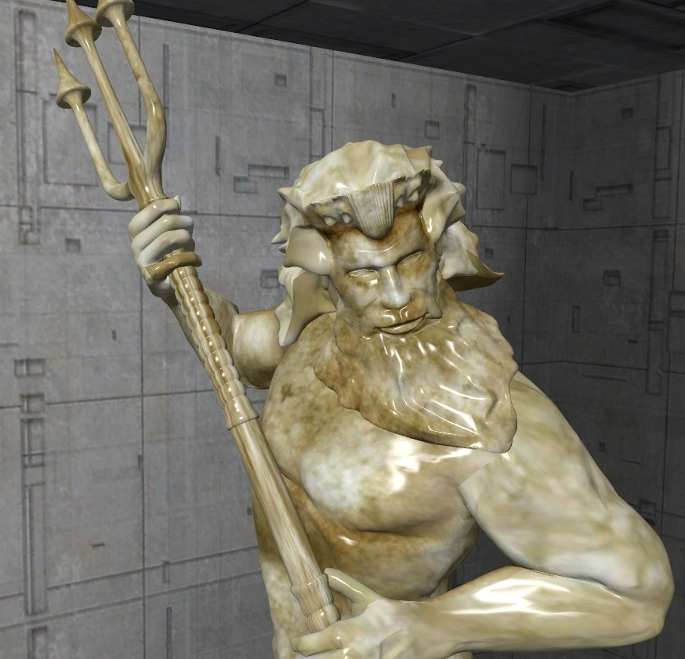
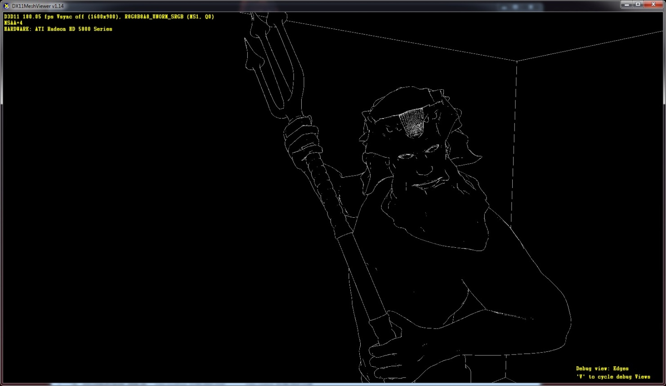

Conclusion
MSAA Edge Detection

Slide 34
Questions?
nicolas.thibieroz@amd.com

Slide 35
Backup

Slide 36

Light Volume Rendering
Early Z culling Optimizations 1
When camera is inside the light volume
  Set Z Mode = GREATER
  Render volume’s back faces
Only samples fully inside the volume get shaded
  Optimal use of early Z culling
  No need for stencil
  High efficiency
Depth test passes
Depth test fails

Slide 37
Light Volume Rendering
Early Z culling Optimizations 2a
Previous optimization does not work if camera is outside volume!
Back faces also pass the Z=GREATER test for objects in front of volume
  Those objects shouldn’t be lit
This results in wasted processing!
Depth test passes
Depth test fails

Slide 38
Light Volume Rendering
Early Z culling Optimizations 2b
Alternative:
When camera is outside the light volume:
  Set Z Mode = LESSEQUAL
  Render volume’s front faces
Solves the case for objects in front of volume
Depth test passes
Depth test fails
Notes:
This also works if object intersect the light volume.
Dotted line means depth test fails.

Slide 39
Light Volume Rendering
Early Z culling Optimizations 2c
Alternative:
When camera is outside the light volume:
  Set Z Mode = LESSEQUAL
  Render volume’s front faces
Solves the case for objects in front of volume
But generates wasted processing for objects behind the volume!
Depth test passes
Depth test fails
Notes:
This also works if object intersect the light volume.
Dotted line means depth test fails.

Slide 40
Light Volume Rendering
Early stencil culling Optimizations
Stencil can be used to mark samples inside the light volume
Render volume with stencil-only pass:
  Clear stencil to 0
  Z Mode = LESSEQUAL
  If depth test fails:
    Increment stencil for back faces
    Decrement stencil for front faces
Render some geometry where stencil != 0
+1
+1
-1
Depth test passes
Depth test fails
Notes:
Well known method of marking samples inside a volume.
Gives perfect efficiency

